Slide 1
UBER ANALYSIS
PRESENTED BY
SOWMIYA S

Slide 2
INTRODUCATION :
Uber is a digital platform that connects customers with transportation and delivery services using a mobile application.
The Uber Dataset Analysis focuses on examining ride booking data to understand overall business performance and customer behavior. The dataset includes important details such as trip time, pickup and drop locations, distance traveled, and fare amount.
This analysis helps identify booking patterns, peak hours, and high-demand locations. By studying these patterns, we can understand when and where most trips occur and how demand changes over time.

Slide 3
PROBLEM STATEMENT :
The main problem in this Uber Dataset Analysis is that large volumes of trip data are available, but they do not directly provide clear business insights.
Without proper analysis, it is challenging to identify which areas generate the highest revenue or when additional drivers are required.
Therefore, this project aims to analyze the data to identify peak booking periods, high-demand locations, revenue trends, and overall performance using key performance indicators (KPIs).

Slide 4
BUSINESS PROBLEM :
The main business problem is how to improve revenue, manage ride demand efficiently, and optimize driver allocation using available trip data.
Although large amounts of ride data are generated daily, the company may face challenges such as uneven demand across locations, peak-hour overload, low utilization during off-peak hours, and fluctuating revenue patterns.
Predict high-demand periods , Allocate drivers effectively , Maximize revenue opportunities , Reduce waiting time for customers , Improve overall operational efficiency

Slide 5
DATA OVERVIEW :
Trip ID
Pickup Time
Dropoff Time
Passenger Count
Trip Distance
PULocation ID
DOLocation ID
Fare Amount
Surge Fee
Vechicle
Payment Type

Slide 6
TECHNOLOGY USED :
Used Microsoft Power BI for data analysis and visualization
Imported Uber dataset into Power BI
Cleaned and transformed data using Power Query
Created relationships between tables
Built calculated measures using DAX formulas
Designed interactive dashboards and reports
Generated business insights through visual charts and graphs

Slide 7
DATA PREPROCESSING :
Removed missing or null values
Eliminated duplicate records
Corrected inconsistent data formats (date & time)
Converted data types (text to date, string to numeric)
Standardized location names . Handled outliers in fare and distance values
Created new calculated columns (Month, Day, Hour)
Prepared clean dataset for KPI analysis and dashboard creation

Slide 8
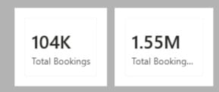
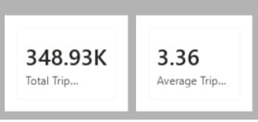
KPI SUMMARY :
Total Bookings
Total Booking Value
Average Booking Value
Total Trip Distance
Average Trip Time

Slide 9
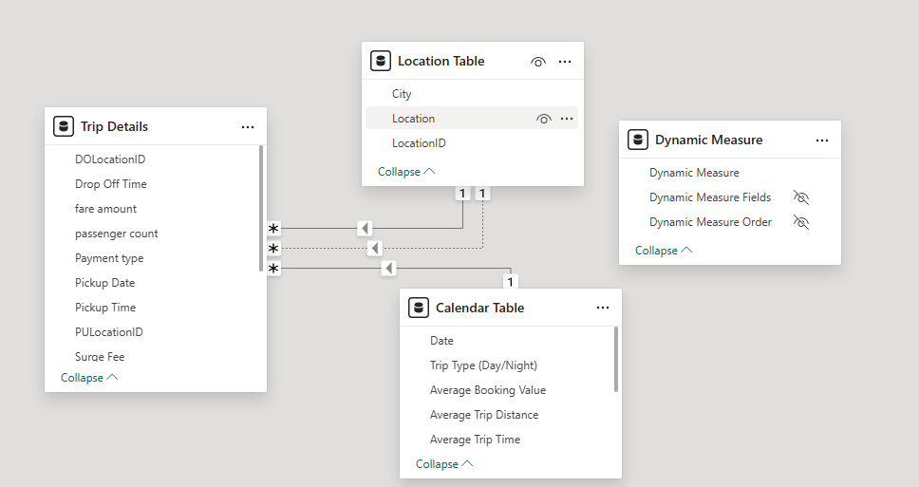
DATA MODELLING :

Slide 10
DAX MEASURES :
DAX is called as [ Data Analysis Expression ]
DAX is a formula language used in power bi
MEASURES :
Total Booking : count(‘trip details’[trip id])
Total Revenue Amount : sum(‘trip details’[fare amount]) + sum(‘trip details’[surge fee])
Total Trip Distance : sum(‘trip details’[trip distance])

Slide 11
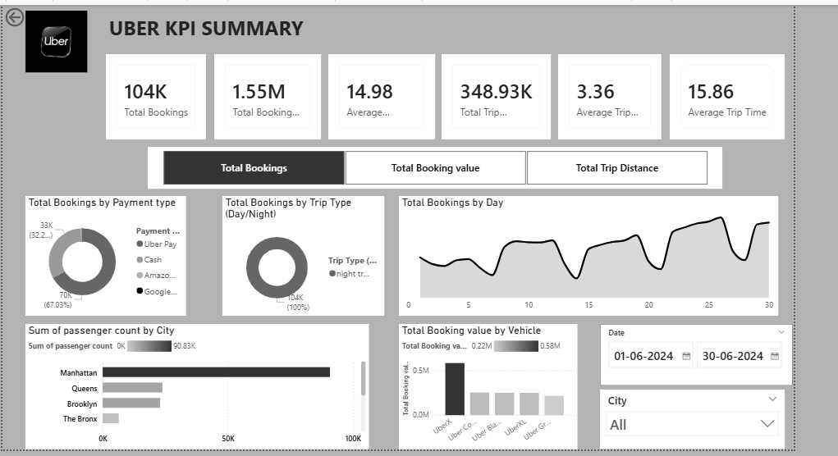
POWER BI DASHBOARD OVERVIEW :

Slide 12
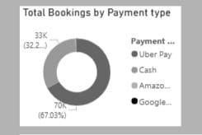
Total BOOKINGS BY PAYMENT TYPE
Donut chart : show payment type of each category to total booking value
Lengend : Payment type
Value : Total Booking Value

Slide 13
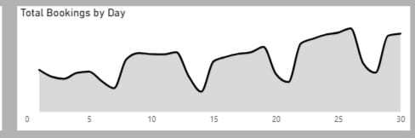
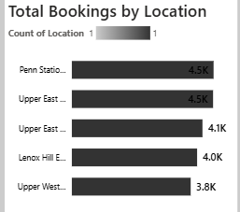
Total BOOKINGS BY DAY :
Area Chart :
X – axis : Day
Y – axis : Total Bookings
TOP 5 LOCATION :
Stacked Bar Chart :
X - axis : Total booking
Y – axis : Location

Slide 14
CONCLUSION
The Uber Dataset Analysis highlights the importance of transforming raw trip data into meaningful business insights. Through detailed examination of ride patterns, revenue distribution, and customer demand trends, the project provides a clear understanding of operational performance.
leveraging data analytics supports smarter decision-making, enhances overall efficiency, and contributes to sustainable business growth. Continuous analysis and dashboard monitoring will ensure long-term success and competitive advantage.
These findings enable better planning, efficient driver management, and improved service delivery .

Slide 15
THANK YOU

